Slide 1

Programming Fundamentals
Week # 02
Powerpoint Templates

Slide 2
ACKNOWLEDGMENTS
These lecture slides contain material from the book “C++ PROGRAMMING (From Problem Analysis to Program Design); Authored by D.S. MALIK
.

Slide 3
Week 2: Course Plan
BASIC ELEMENTS OF C++
First C++ Program
Analysis of the program
Escape sequences
Manipulators
Example programs
Comments & Tokens

Slide 4
Basic Concepts
Computer Program: A sequence of statements whose objective is to accomplish a task
Programming: Process of planning and creating a program
Programming language: A vocabulary and set of grammatical rules for instructing a computer or computing device to perform specific tasks
OR
A set of rules, symbols, and special words
Syntax: Rules that specify which statements (instructions) are legal

Slide 5
C++ Programs
A C++ program is a collection of one or more subprograms, called functions
A subprogram or a function is a collection of statements that, when activated (executed), accomplishes something
Every C++ program has a function called main
The smallest individual unit of a program written in any language is called a token
Notes:
A token is the smallest element of a C++ program that is meaningful to the compiler.

Slide 6
1: First C++ Program
Hello to C++ World Program (already learnt)
#include <iostream>
using namespace std;
int main()
{
cout << “Hello to C++ World.” << endl;
return 0;
}

Slide 7
2: Analysis of the Program
C++ output statement
Cout << “Hello to C++ World.” << endl;
This output statement causes the computer to evaluate the expression after the pair of symbols << and display the result on the screen
endl causes the insertion point to move to the beginning of the next line
String: anything in double quotes

Slide 8
Analysis of the Program
#include <iostream>
allows to use the (predefined object) cout to generate output and the (manipulator) endl
using namespace std;
allows to use cout and endl without the prefix std::
Without this statement
cout should be used as std::cout
endl should be used as std::endl

Slide 9
Analysis of the Program
int main()
A C++ program is a collection of functions, one of which is the function main
Above is heading of function main
A function is a set of statements whose objective is to accomplish something
Only one function in our first program (main)
all C++ programs require a function main

Slide 10
Analysis of the Program
int main()
{
}
Left brace
Marks beginning of body of the function main
Right brace
Matches with left brace
Marks end of the body of function main
return 0;
returns the value 0 to the operating system when the program terminates

Slide 11
Analysis of the Program
Preprocessor Directives
C++ has a small number of operations
Many functions and symbols needed to run a C++ program are provided as collection of libraries
Every library has a name and is referred to by a header file
Preprocessor directives are commands supplied to the preprocessor
All preprocessor commands begin with #
No semicolon at the end of these commands

Slide 12
Analysis of the Program
Syntax to include a header file
#include <headerFileName>
Causes the preprocessor to include the header file iostream in the program
The syntax is:
#include <iostream>

Slide 13
Using cin and cout in a Program and namespace
cin and cout are declared in the header file iostream, but within a namespace named std
To use cin and cout in a program, use the following two statements:
#include <iostream>
using namespace std;

Slide 14
Using the string Data Type in a Program
To use the string type, you need to access its definition from the header file string
Include the following preprocessor directive:
#include <string>

Slide 15
3: Escape Sequences
used to represent certain special characters
In character or string literals
Escape Sequence | Name | Description
\t | Tab character | It moves the cursor to the next tab stop.
\v | Vertical tab | It moves the cursor to the next vertical tab stop.
\a | Alert or bell character | It produces a beep or sound.
\r | Carriage return | It moves the cursor to the beginning of the line.

Slide 16
3: Escape Sequences
used to represent certain special characters
In character or string literals
Escape Sequence | Name | Description
\’ | Single quote character | It is used to represent a single quote.
\” | Double quote character | It is used to represent a double quote.
\b | Backspace character | It moves the cursor back one character.
\n | New line character | It moves the cursor to the next line.

Slide 17
4: Manipulators
Manipulators are helping functions that can modify the input/output stream.
These are values to be used to insert into or extract from iostreams to have special effects
They only modify the I/O stream using insertion (<<) and extraction (>>) operators
Does not change the value of a variable

Slide 18
5. Comments
inclusion of comments in the program makes it clearer to programmer and reader
comments are for readers
Compiler completely ignores comments
Single line comments (//)
Begin with //
Can be placed anywhere in the line
Everting after // in line is ignored by compiler
Multiple line comments (/* and */)
Enclosed between /* and */
Anything between them is ignored by compiler

Slide 19
5. Tokens / Symbols
The smallest individual unit of a program written in any language is called a token
Special symbols
Reserved Word symbols
Identifiers

Slide 20
Tokens
Special Symbols
Mathematical symbols: + - * /
Punctuation marks: . ; ? ,
Token made up of two characters: <= != == >=
No character can come between two characters
Commas are used to separate items in a list
Semicolons are used to end a C++ statement
Blank is also a special symbol
Created by pressing the spacebar on keyboard

Slide 21
Tokens
Reserved Word Symbols (keywords)
int, float, double, char, const, void, return
Also called keywords
Always in lowercase letters
Each is considered as a single symbol
Cannot be redefined within any program
Cannot be used for anything other than intended use

Slide 22
Tokens
Identifiers
Identifiers are names of things that appear in programs
variables
constants
Functions
Must obey C++ identifier rules
A C++ identifier consists of letters, digits, and underscore (_) character
Must begin with letter or underscore
Some are predefined (cout)
Some are defined by users (like length)

Slide 23
Tokens
Identifiers
Illegal Identifiers:
employee salary: cannot be space between employee and salary
Hello! : The exclamation mark cannot be used
one + two: symbols such as + cannot be used
2nd: cannot start with a digit

Slide 24
Whitespaces
Every C++ program contains whitespaces.
Whitespaces include blanks, tabs, and newline characters.
In a C++ program, whitespaces are used to separate special symbols, reserved words, and identifiers.
Whitespaces are nonprintable in the sense that when they are printed on a white sheet of paper, the space between special symbols, reserved words, and identifiers is white.
Proper utilization of whitespaces in a program is important.
They can be used to make the program more readable.

Slide 25
Use of Blanks
Use of Blanks
One or more blanks separate input numbers
Blanks are also used to separate reserved words and identifiers from each other and other symbols
Blanks between identifiers in the second statement are meaningless:
int a,b,c;
int a, b, c;
In the statement: inta,b,c;
no blank between the t and a changes the reserved word int and the identifier a into a new identifier, inta.

Slide 26
Commas, Semicolons, & Brackets
Commas separate items in a list
All C++ statements end with a semicolon
Semicolon is also called a statement terminator
{ and } are not C++ statements

Slide 27
Semantics
The set of rules that gives meaning to a language is called a semantics
Possible to remove all syntax errors in a program and still not have it run
Even if it runs, it may still not do what you meant it to do
For example,
2 + 3 * 5 and (2 + 3) * 5
are both syntactically correct expressions, but have different meanings

Slide 28
Prompt lines
Prompt lines are executable statements that inform the user what to do.
cout << "Please enter a number between 1 and 10 and " << "press the return key" << endl;
cin >> num;
In a program, whenever input is needed from users, you must include the necessary prompt lines

Slide 29
Form and Style
Consider two ways of declaring variables:
Method 1
int feet, inch;
double x, y;
Method 2
int a,b;double x,y;
Both are correct, however, the second is hard to read

Slide 30
Data Types
Data Type: A data type specifies the type of data that a variable can store such as integer, floating, character etc.
C++ data can be classified into three categories:
Simple data type
Structured data type
Pointers

Slide 31
Simple Data Types
Three categories of simple data
Integral: integers (numbers without a decimal)
Floating-point: decimal numbers
Enumeration type: user-defined data type

Slide 32
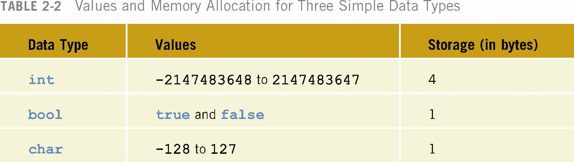

Slide 33
int Data Type
Examples:
-6728
0
78
Positive integers do not have a + sign in front of them
No commas are used within an integer
Commas are used for separating items in a list

Slide 34
bool Data Type
bool type
Has two values, true and false
Manipulate logical (Boolean) expressions
true and false are called logical values
bool, true, and false are reserved words

Slide 35
char Data Type
The smallest integral data type
Used for characters: letters, digits, and special symbols
Each character is enclosed in single quotes
Some of the values belonging to char data type are: 'A', 'a', '0', '*', '+', '$', '&'
A blank space is a character and is written ' ', with a space left between the single quotes

Slide 36
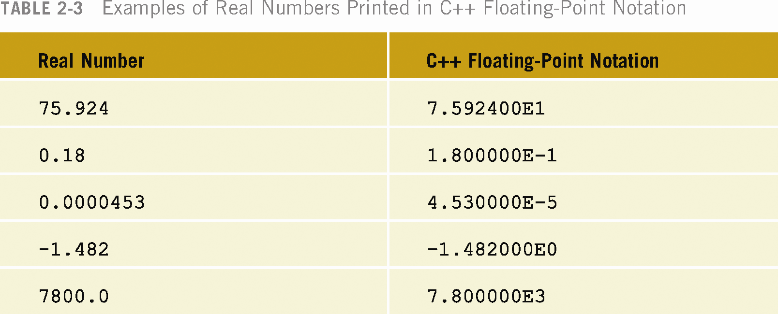
Floating-Point Data Types
C++ uses scientific notation to represent real numbers (floating-point notation)

Slide 37
Floating-Point Data Types (continued)
float: represents any real number
Range: -3.4E+38 to 3.4E+38
Memory allocated for the float type is 4 bytes
double: represents any real number
Range: -1.7E+308 to 1.7E+308
Memory allocated for double type is 8 bytes
On most newer compilers, data types double and long double are same

